Slide 1

AN OVERVIEW & WALKTHROUGH
The Game Caddie
Play smarter, faster, and have more fun.
An Excel utility for getting the most out of APBA Golf
Notes:
⏱ Estimated: ~1:00 • Running total: ~1:00
Hello, friends. If you've played APBA Golf around the table, you already know how much you love the game — and how much dice-rolling, chart-reading, and arithmetic it can take to get through a round.
Today I want to introduce you to the Game Caddie. It's an Excel-based utility built to handle all of that math for you, so you can spend your time playing golf instead of crunching numbers.
Over the next several minutes I'll walk you through what the Game Caddie is, what you need to run it, and then a full step-by-step of how a round actually plays out — from setup all the way to the final scorecard. By the end, you’ll have a good idea of how the Game Caddie can make playing APBA Golf even more enjoyable.

Slide 2
What is the Game Caddie?
An Excel workbook utility that makes playing the APBA Golf Game easier, faster, and more fun — helping you focus on strategy instead of math.
1
2
3
Easier
Faster
More Fun
Automates many tasks, so you spend your time playing, not calculating.
Speeds up play by helping you plan and execute shots more quickly.
Makes playing APBA Golf more about strategy and performance than crunching numbers.
The Game Caddie – www.thegamecaddie.com
2
Notes:
⏱ Estimated: ~0:55 • Running total: ~1:55
So what exactly is the Game Caddie? At its core, it's an Excel workbook that sits alongside the APBA Golf Game you already own. It doesn't replace the game — it takes over the tedious parts.
I think about the value in three words. First, easier: it automates many of the tasks you'd normally do by hand, so there's far less to track. Second, faster: it helps you plan and execute each shot quickly, which keeps a round moving. And third, more fun: because you're not buried in the math, you get to focus on strategy and performance — the actual golf decisions.
That's the whole idea — keep everything you love about APBA Golf, and take away the busywork.

Slide 3
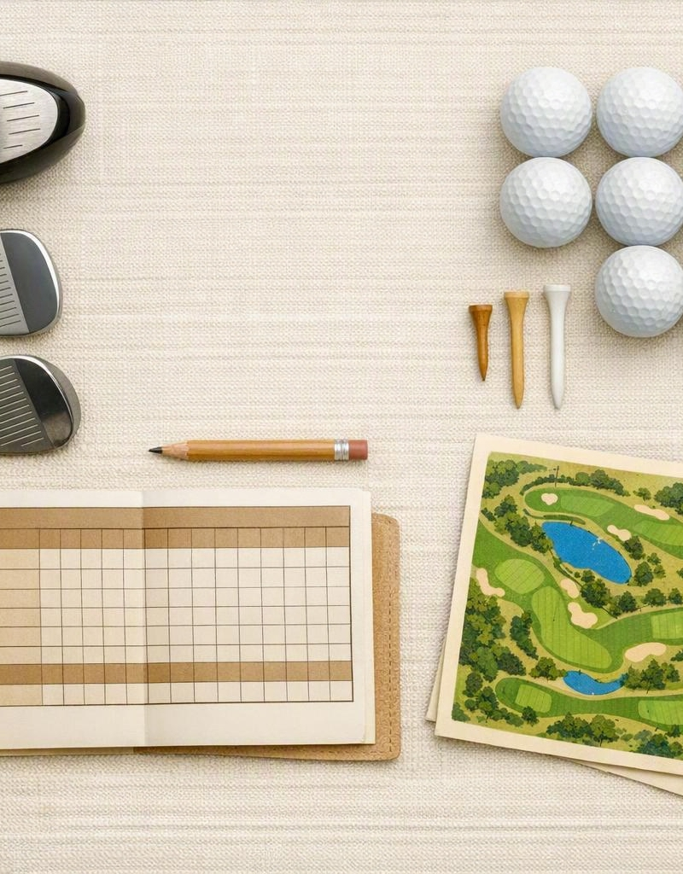
Before you start
What you need to use the Game Caddie
✓
MS Excel 2021 or later
Installed locally on your PC.
✓
The current APBA Golf Game
The current edition is copyright 2014.
✓
Player cards
For each APBA golfer you want to play.
✓
Courses
The APBA courses you'd like to play.
3
Notes:
⏱ Estimated: ~0:45 • Running total: ~2:40
Before we dig into gameplay, let's make sure you've got everything you need to use the Game Caddie. There are four things.
First, Microsoft Excel — 2021 or later, installed locally on your PC. Second, the current APBA Golf Game itself; the current edition is copyright 2014, and the Game Caddie is built around it. Third, player cards for each APBA golfer you want to play. And fourth, the courses — whichever APBA courses you'd like to play.
If you've got those four things, you're ready. The Game Caddie doesn't require anything exotic — just the game you already own and a reasonably current copy of Excel.

Slide 4
Who can play
UP TO
Solo or social
4
Play on your own, or alongside up to three other golfers.
Shared or separate
golfers at a time
Use a single shared copy of the Game Caddie, or have each player run their own from their own machine.
in stroke-play format
The Game Caddie – www.thegamecaddie.com
4
Notes:
⏱ Estimated: ~0:40 • Running total: ~3:25
The Game Caddie is flexible about who's at the table. You can play solo, on your own, or socially alongside up to three other golfers — so up to four players at a time, all in stroke-play format.
You've also got a choice in how you run it. You can use a single shared copy of the Game Caddie that the whole group works from together, or each player can run their own copy on their own machine.
Either way works, so pick whatever suits your group and your setup.

Slide 5
Inside the workbook
The program is built from 15 worksheets (tabs) — but a single round usually touches as few as four.
15
Caddie tab
Conditions tab
Where you plan and take shots
Wind, course conditions, and pin number
Course tab
Scorecard tab
worksheets in all
You'll mainly use the four shown here
The holes you’ll be playing
Scores and round stats
The Game Caddie – www.thegamecaddie.com
5
Notes:
⏱ Estimated: ~0:50 • Running total: ~4:10
Let's look under the hood for a second. The Game Caddie is built from fifteen worksheets, or tabs, in all. Now, that might sound like a lot — but don't let it intimidate you. A single round usually only touches about four of them.
The four you'll live in are: the Caddie tab, where you plan and take your shots; the Conditions tab, where you set wind, course conditions, and the pin number; the Course tab, which holds the holes you'll be playing; and the Scorecard tab, which tracks your scores and round stats.
Understand what those four tabs do and you essentially know how to use the Game Caddie.

Slide 6
Two ways to play
Basic Game
Master Game
Simple and quick
Full-featured and strategic
Mirrors the original 1960s APBA Golf Game
Fewer rules
Fewer golfing “obstacles” to overcome
Relatively quick gameplay
Supports every feature of the current APBA Golf game
Allows many “homebrew” options
More strategy
More realistic
Takes a little longer to play
The Game Caddie – www.thegamecaddie.com
6
Notes:
⏱ Estimated: ~0:50 • Running total: ~5:00
The Game Caddie supports two modes of play. The first is the Basic Game — simple and quick. It mirrors the original 1960s APBA Golf Game, with fewer rules and fewer golfing obstacles to overcome, so it plays relatively fast.
The second is the Master Game — full-featured and strategic. It supports every feature of the current APBA Golf game, allows a lot of homebrew options, and gives you more strategy and more realism. The trade-off is that it takes a little longer to play.
Neither one is better — it just depends on whether you're after a quick round or the full, simulation experience.

Slide 7
Basic vs Master Game
Basic Game mode uses APBA’s simplified rules and limits which features are available. Master Game mode can handle all APBA rules and accommodates some “homebrew” features as well.
Feature | Basic Game | Master Game
Player Ratings | ◐ Avg W/I | All
Momentum / Bounce-back Points | Yes | Yes
Aim | ◐ Optional | Yes
Work the Ball | ◐ Optional | Yes
Wind Effects | No | Yes
Lie Effects | No | Yes
Dogleg Effects | No | Yes
Lie Club Restrictions | ◐ Some | All
Tree Clearance Restrictions | No | Yes
Play Safe Option | No | Yes
Short-sided vs. Good Angle | No | Yes
Hole and Terrain Notes | ◐ Some | All
The Game Caddie – www.thegamecaddie.com
7
Notes:
⏱ Estimated: ~0:50 • Running total: ~5:50
Here's a side-by-side of what each mode actually gives you. In Basic Game mode, you're using APBA's simplified rules, and a number of features are limited or turned off. The only player ratings that are required in the Basic Game are Average W and Average I. Things like aiming and working-the-ball are optional, and effects like wind, lie, and doglegs aren't in play.
Master Game mode, as shown on the right, allows you to use everything: full player ratings, wind effects, lie effects, dogleg effects, tree-clearance restrictions, the play-safe option, short-sided versus good-angle, and the complete hole and terrain notes. However, you always have the option to ignore or turn off some features.
You don't need to memorize this table — the takeaway is simply that the Basic Game mode keeps it lean, and Master Game mode gives you all the bells and whistles.

Slide 8
How long is a round?
For an experienced player with a single golfer
~50
<75
minutes
minutes
Basic Game
Master Game
Times increase with more golfers and on courses with more rules.
The Game Caddie – www.thegamecaddie.com
8
Notes:
⏱ Estimated: ~0:40 • Running total: ~6:30
A natural question: how long does a round take? For an experienced player running a single golfer, a Basic Game round comes in around fifty minutes, and a Master Game round is typically under seventy-five minutes.
Keep in mind those are baseline numbers — times go up as you add more golfers to the group, and on courses that impose more local rules and special features.
But as a rule of thumb, plan for roughly an hour, give or take, once you're comfortable with the tool.

Slide 9
Getting set up
Five easy steps before your first tee shot
1
›
2
›
3
›
4
›
5
Import a course
Configure the Game Caddie settings
Set the Day Conditions and Pin number
Enter the Player Ratings
Select optional clubs
The Game Caddie – www.thegamecaddie.com
9
Notes:
⏱ Estimated: ~0:35 • Running total: ~7:10
Now let's get practical. Before your first tee shot, there are five easy setup steps.
One: import a course. Two: configure the Game Caddie settings. Three: set the day conditions and the pin number. Four: enter the player ratings. And five: select your optional clubs.
That's the entire setup sequence. In the next part of the presentation I'll walk through each of these on screen, one at a time, so you can get a sense of where to click and what to enter.
But first, let’s take a high-level look at how you play.

Slide 10

Playing a hole
1
Load a hole
5
Select a club and take the shot
2
Observe or enter any wind conditions
6
Move the ball marker and record the shot
3
Consult the hole notes
7
Continue until all players putt out and record the hole
4
Plan the shot
8
View stats on the Scorecard
The Game Caddie – www.thegamecaddie.com
10
Notes:
⏱ Estimated: ~0:45 • Running total: ~7:50
Once you're set up, playing a hole follows a consistent rhythm — the same eight steps every time.
You load a hole, observe or enter any wind conditions, and consult the hole notes. Then you plan the shot, select a club and take the shot, and move the ball marker and record the result. You keep that cycle going — plan, shoot, record the shot. After the last player putts out, you record the scores and head to the next tee.
Once you internalize this loop, the whole round becomes second nature. Let's now walk through it all in detail.

Slide 11
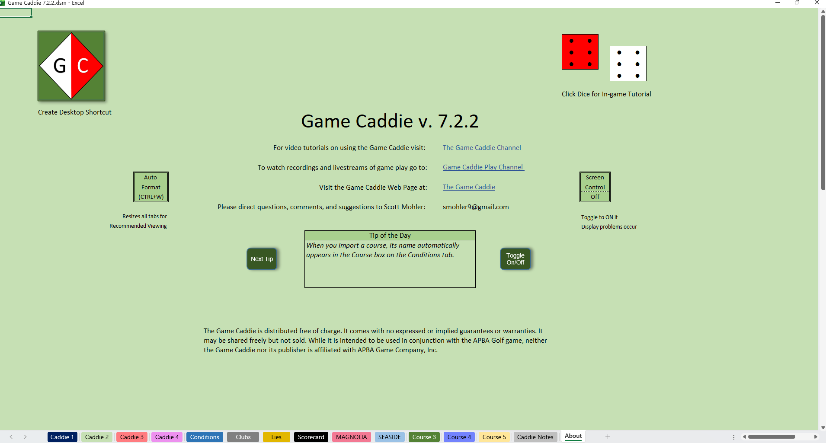
A STEP-BY-STEP WALKTHROUGH
How the Game Caddie Works
Notes:
⏱ Estimated: ~0:30 • Running total: ~8:20
Alright — that's the overview. Now let's get into the actual step-by-step walkthrough and see how the Game Caddie works in practice.
I'll take you through the complete flow: first the setup steps we just listed, and then playing a hole from the tee all the way to the scorecard.

Slide 12
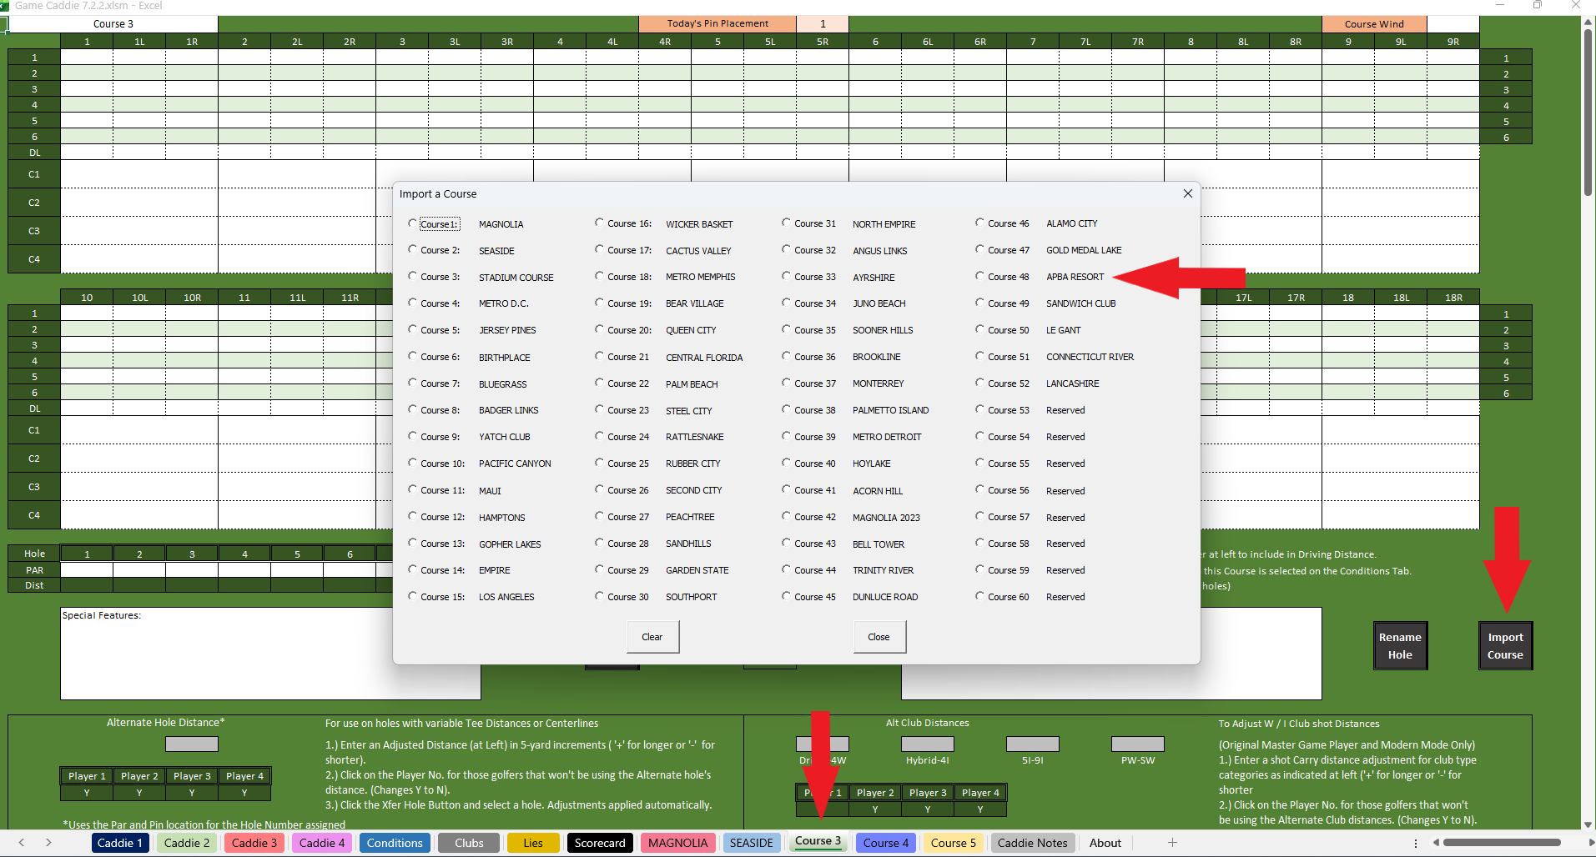
Setup: Import a course
1
Import the course you want to play
From any Course tab, click Import Course and select a course you own.
1
2
The Game Caddie – www.thegamecaddie.com
12
Notes:
⏱ Estimated: ~0:35 • Running total: ~8:55
Setup step one: import a course. From any Course tab, you'll click the Import Course button and select a course you own. That puts the course data into position, so the Game Caddie can access all the information it contains. For this example we’re going to import the APBA Resort course.

Slide 13
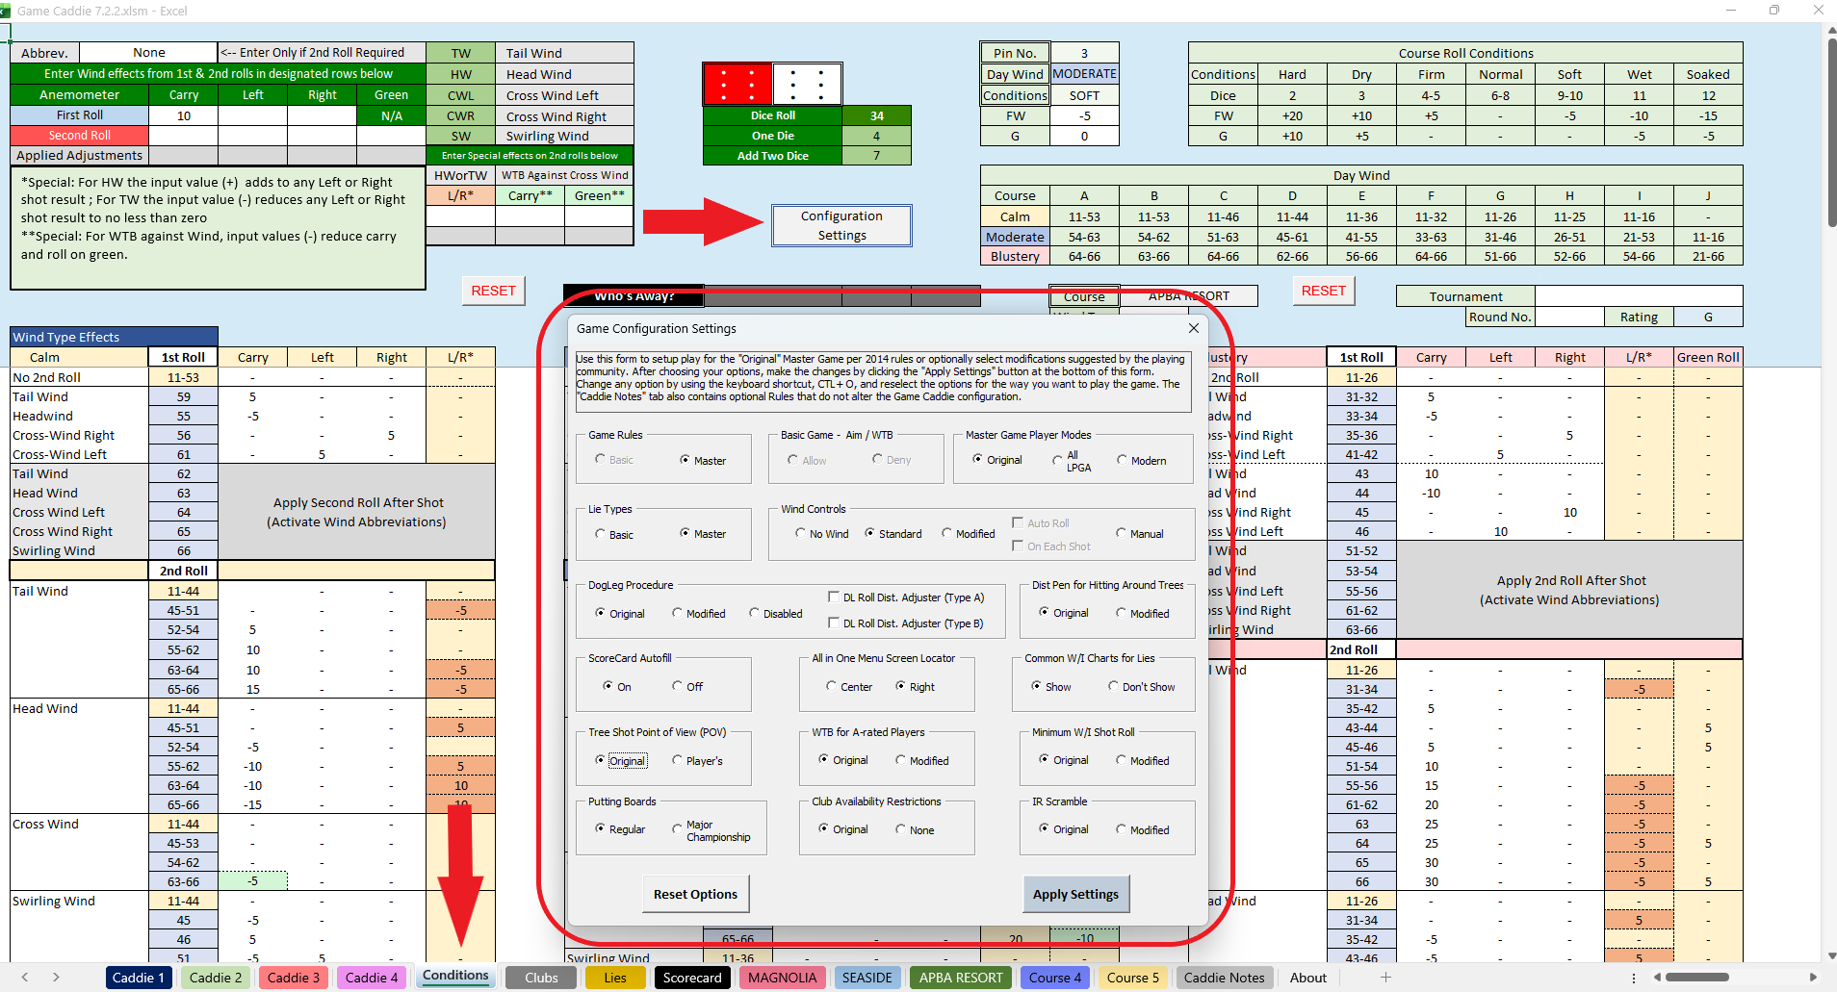
Setup: Configure the game settings
2
Select game and display preferences
From the Conditions tab, click Configuration Settings and choose from the available options.
2
The Game Caddie – www.thegamecaddie.com
13
Notes:
⏱ Estimated: ~0:40 • Running total: ~9:30
Step two: configure the game settings. Head to the Conditions tab and click Configuration Settings. This is where you choose your game and display preferences.
That includes things like whether you're playing Basic Game or Master Game rules, plus other options we'll see come into play later — such as which putting boards to use or whether the scorecard fills in automatically.

Slide 14
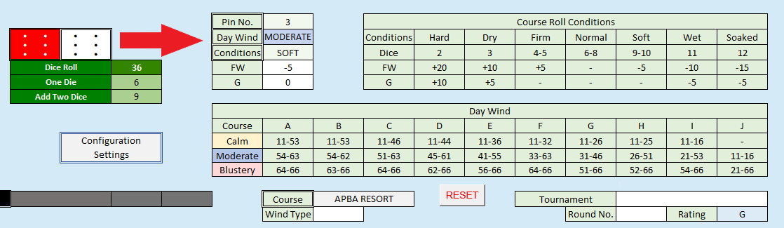
Setup: Day conditions & pin number
3
Assign day wind, course conditions, and pin number
To roll the dice, click the Dice Roller (dice graphic).
Consult the tables on the Conditions tab to determine wind and course conditions for the day.
Click the Pin No., Day Wind, and Conditions boxes to cycle through the settings until you find the ones you want.
2
The Game Caddie – www.thegamecaddie.com
14
Notes:
⏱ Estimated: ~0:35 • Running total: ~10:10
Step three: set the day conditions and the pin number. Still on the Conditions tab, click on the Dice image to roll the dice. Then consult the two tables to determine the day's wind and course conditions. Note the wind rating — G in this case — at the lower right. Use that rating to determine which Day Wind column to use.
To register your choices simply click the Pin Number, Day Wind, and Conditions boxes to cycle through the settings until you land on the ones you want. These boxes are displayed to the right of the red arrow.
This establishes the playing environment for the whole round before anyone tees off.

Slide 15
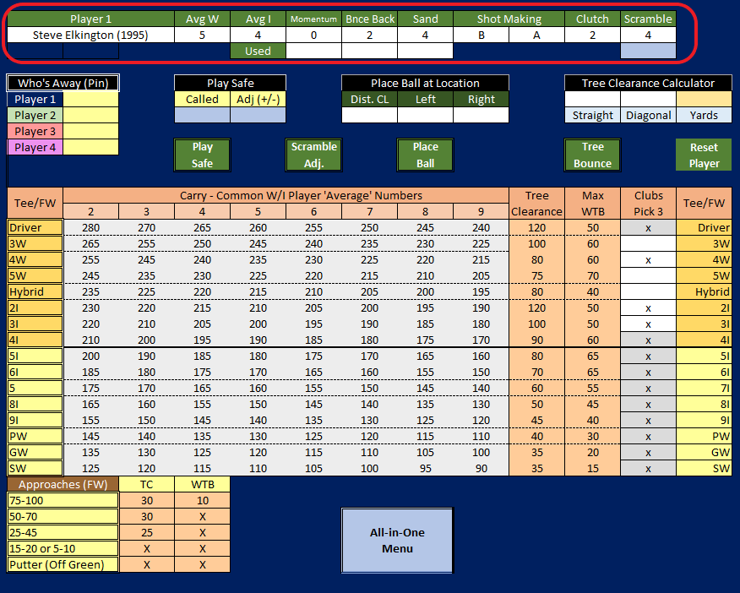
Setup: Enter player ratings
4
Enter player ratings for all golfers in the group
Type in the player’s Master Game ratings on any Caddie tab. If using Basic Game rules, only Avg W and Avg I are required.
2
The Game Caddie – www.thegamecaddie.com
13
Notes:
⏱ Estimated: ~0:30 • Running total: ~10:40
Step four: enter the player ratings for every golfer in the group. On any Caddie tab, you type in each player's Master Game ratings.
One handy shortcut — if you're playing Basic Game rules, you only need to enter the average wood and average iron ratings; the rest aren't required.
So enter ratings for everyone in your group — one per Caddie tab — and the Game Caddie will use them throughout the round.

Slide 16
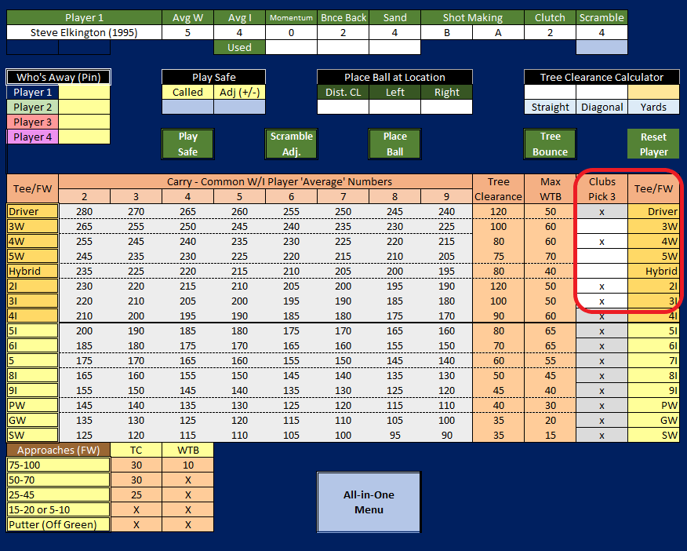
Setup: Pick three clubs
5
Select which three clubs to add to the player’s bag
Type an ‘x’ in the Clubs Pick 3 column to choose which optional clubs (3W – 3I) to add to the player’s bag. You can override this selection in the Game Configuration Settings, if you want all clubs to be available.
2
The Game Caddie – www.thegamecaddie.com
14
Notes:
⏱ Estimated: ~0:35 • Running total: ~11:15
Step five, the last setup step: pick three clubs. In the Clubs Pick 3 column, you type an 'x' to choose which optional clubs — the three-wood through three-iron range — you want to add to the player's bag.
If you'd rather have every club available instead, you can override this in the Game Configuration Settings.
And that's it for setup — course imported, settings configured, conditions and pin set, ratings entered, clubs chosen. Now we play.

Slide 17
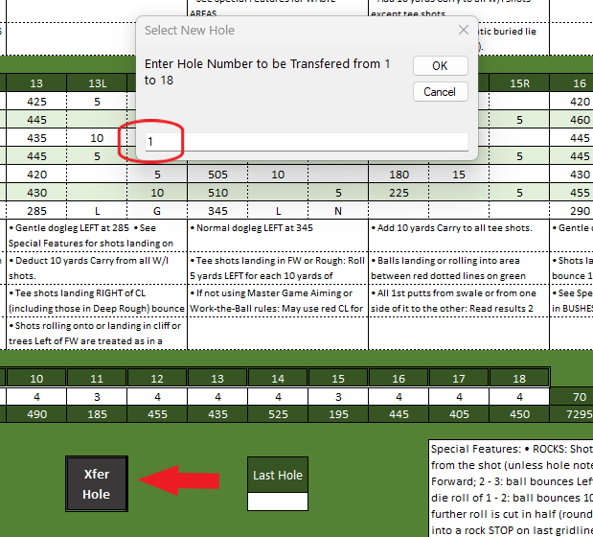
Play: Load a hole
1
Load the hole you want to play
From the Course tab for your selected course, click Xfer Hole and enter the hole number.
2
The Game Caddie – www.thegamecaddie.com
15
Notes:
⏱ Estimated: ~0:30 • Running total: ~11:45
Now for the fun part. Step one of a hole: load it. From the Course tab for your selected course, click Xfer Hole and enter the hole number you want to play.
That transfers the hole's data into the Caddie tabs, so everything you need for that specific hole is right in front of you. Simple as that — pick your hole, transfer it, and you're on the tee.

Slide 18
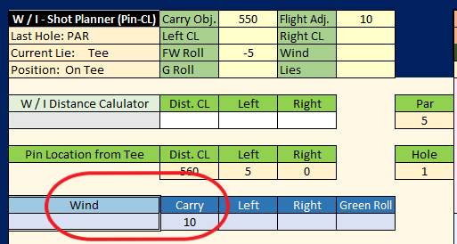
Play: Note, select, or enter hole wind
2
Observe, choose, or enter the type and amount of wind for the hole
Depending on your game setup and course, you may have no wind, standard wind, or modified wind.
For standard wind: All wind rolls and assignments are performed automatically (as shown).
For modified wind: Choose or enter the type of wind from a pop-up menu (not shown).
2
The Game Caddie – www.thegamecaddie.com
16
Notes:
⏱ Estimated: ~0:40 • Running total: ~12:25
Step two: Consider the wind for the hole. Depending on your game setup and the course, you'll have one of three situations — no wind, standard wind, or modified wind.
With standard wind, the Game Caddie does the work for you: all the wind rolls and assignments happen automatically. With modified wind, you'll choose or enter the type of wind yourself from a pop-up menu.
Either way, once the wind is set, you know exactly what you're playing into before you plan your shot.
Normally, whether you use standard wind or modified wind is determined by the course you are playing. Whenever a course has special wind conditions, such as Prevailing Winds, you would select modified wind in the Game Configuration settings.

Slide 19
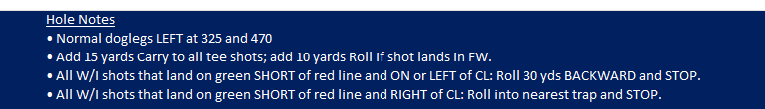
Play: Consult terrain & course notes
3
Read notes from the APBA course boards
Many APBA courses have course notes and terrain notes. The latter, which apply to all holes, are usually displayed in the Special Features boxes on the Course tab.
Normally, you only need to consult the terrain notes at the start of play and in those situations mentioned.
Course notes pertain to specific holes and are called Hole Notes in the Game Caddie. They can be found at upper right on each Caddie tab after loading the hole.
You have the option of ignoring or following any note instructions. On its own, the Game Caddie does not do anything with terrain or course notes but provides various ways for the user to implement them.
2
The Game Caddie – www.thegamecaddie.com
17
Notes:
⏱ Estimated: ~0:55 • Running total: ~13:20
Step three: consult the terrain and course notes. Many APBA courses come with two kinds of notes.
Terrain notes apply to all holes and usually show up in the Special Features boxes on the Course tab — you typically only need to check those once at the start of play, and in the specific situations they mention. Course notes, which the Game Caddie calls Hole Notes, pertain to individual holes and appear at the upper right of each Caddie tab after you load the hole.
Here's an important point: the Game Caddie doesn't act on these notes for you — it's your call whether to follow or ignore them. It just surfaces them and gives you ways to apply them.

Slide 20
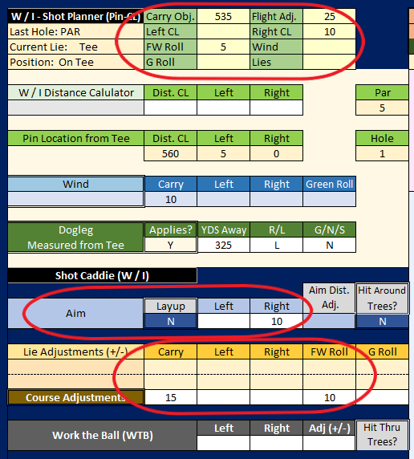
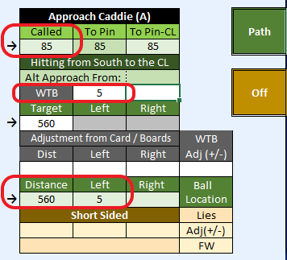
Play: Plan the shot
4
Consult the W/I Shot Planner or Approach Caddie to plan the shot
For shots > 100 yards: the W/I Shot Planner can help you decide how much to aim or work-the-ball, and the distance to your target.
For shots ≤ 100 yards: the Approach Caddie can help you decide how much to aim or work-the-ball, and the called distance to your target.
2
The Game Caddie – www.thegamecaddie.com
18
Notes:
⏱ Estimated: ~0:45 • Running total: ~14:05
Step four: plan the shot. The Game Caddie gives you two planning tools depending on distance.
For shots longer than a hundred yards, use the W/I Shot Planner — it helps you decide how much to aim or work the ball, and the distance to your target. For shots of a hundred yards or less, you use the Approach Caddie, which calculates your called distance to the target. It also allows you to aim or work-the-ball if your called distance is at least 75 yards. You do not need to plan shots 20 yards or less from the pin.
So the tool matches the shot: long game uses the Shot Planner, short game uses the Approach Caddie.

Slide 21
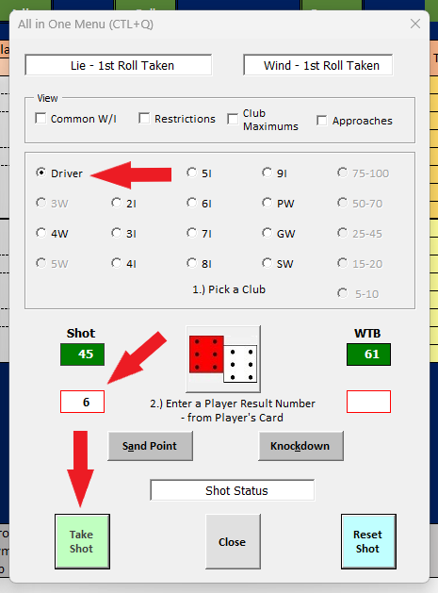
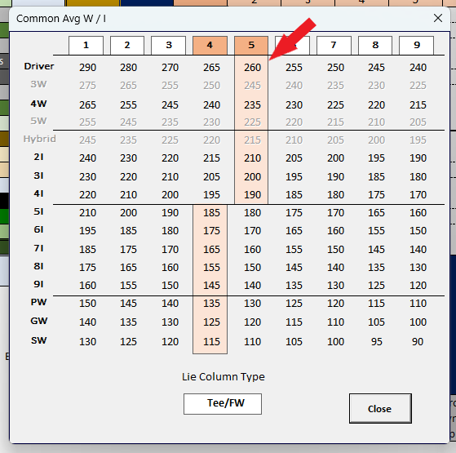
Play: Select a club & take the shot
5
Use the Common Avg W/I Chart and All-in-One Menu
For W/I shots: Choose a club based on the player’s average carry distances. For Approach shots: Use the Called or To Pin distance (if ≤ 20 yards).
Use the All-in-One Menu to select the club, roll the dice, enter the Play Result Number, take the shot, and more.
2
The Game Caddie – www.thegamecaddie.com
19
Notes:
⏱ Estimated: ~0:45 • Running total: ~14:50
Step five: select a club and take the shot. For your wood and iron shots, you'll use the Common Average W/I Chart to choose a club based on the player's average carry distances. For approach shots, you use the called distance or to-pin distance — if it's twenty yards or less.
Then the All-in-One Menu ties it all together: from there you select the club, roll the dice, enter the Play Result Number, and take the shot. You can also knock down shots, use sand points, and consult other planning tools from here.
The All-in-One menu is really the command center for executing each shot.

Slide 22
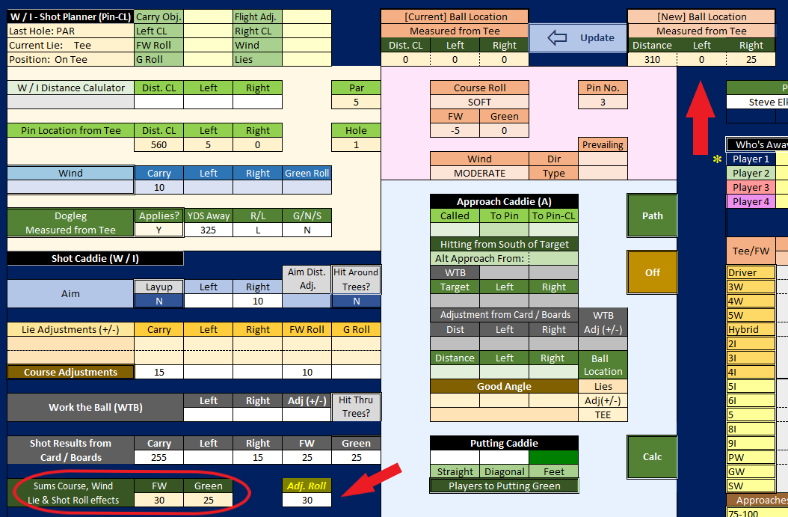
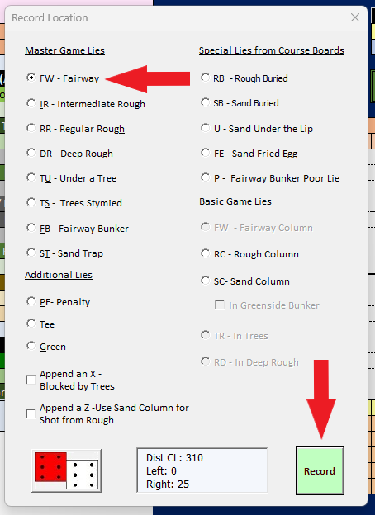
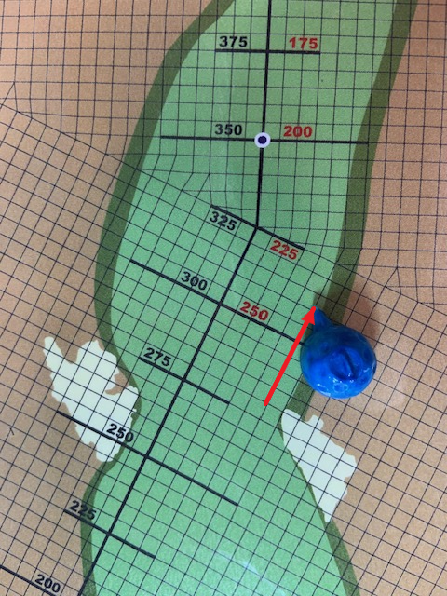
Play: Move the Ball & Record the Shot
6
Determine the ball’s new shot location and record its lie
The (New) Ball Location shows where the shot carried to (top red arrow). Enter the roll amount (bottom red arrow) after checking the course terrain.
Record the shot by selecting the new lie.
APBA course board
2
The Game Caddie – www.thegamecaddie.com
20
Notes:
⏱ Estimated: ~0:40 • Running total: ~15:30
Step six: move the ball and record the shot. After the shot, the New Ball Location shows you where the ball carried to — that's the top red arrow on screen.
You then check the course terrain and enter the roll amount — the bottom red arrow — to account for how far it rolls. Finally, you record the shot by clicking the Update arrow — in blue at top — and select the new lie.
That tells the Game Caddie what it needs to know for your next shot, and it ties into what the APBA course board shows.

Slide 23
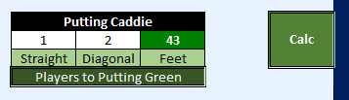
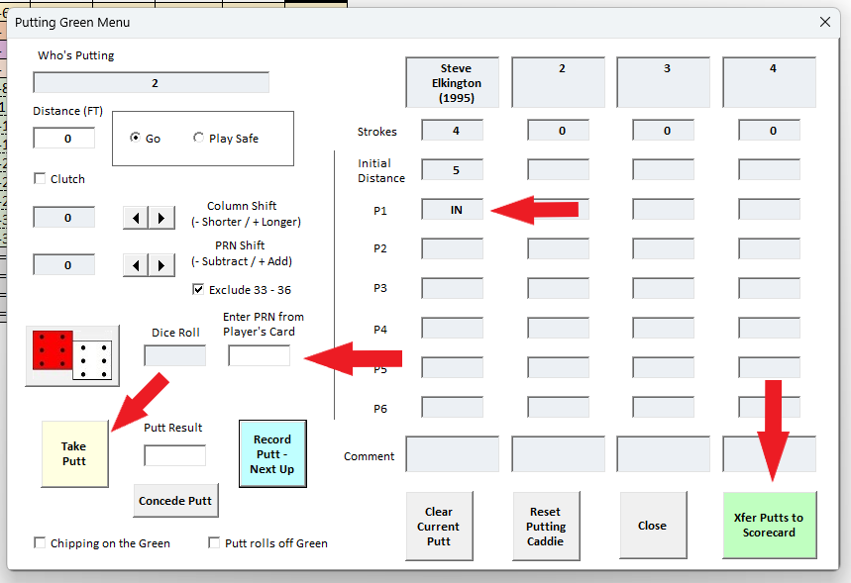
Play: On the green
7
Calculate putting distance, then putt out
Once a player is on the green, use the Putting Caddie to determine putting distance.
Enter the number of straight and diagonal squares from the ball to the pin and click Calc.
You can choose which Putting Boards to use (Original or Major Championship) in the Configuration Settings.
To Putt: Select Go or Play Safe, click the Dice Roller, enter the PRN from the player’s card, and click Take Putt.
Click Record Putt – Next Up.
Repeat the above steps until everyone putts out.
When all players are done putting, click Xfer Putts to Scorecard.
2
The Game Caddie – www.thegamecaddie.com
21
Notes:
⏱ Estimated: ~0:50 • Running total: ~16:20
Step seven: putting. Once a player reaches the green, you use the Putting Caddie to figure out the putting distance — just enter the number of straight and diagonal squares from the ball to the pin and click Calc.
To putt, you select Go or Play Safe, click the Dice Roller, enter the Play Result Number from the player's card, and click Take Putt. Then click Record Putt – Next Up, and repeat until everyone has putted out.
One nice option: you can choose which putting boards to use — Original or Major Championship — back in the Configuration Settings. And when all players finish, click Xfer Putts to Scorecard.

Slide 24
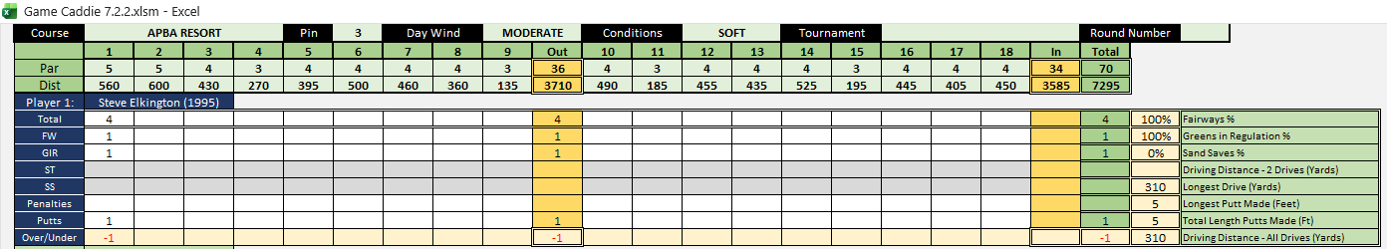
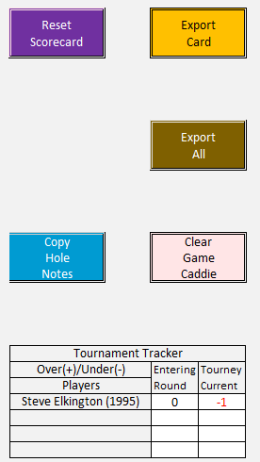
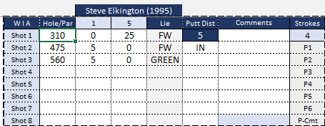
Play: View stats on the scorecard
8
The scorecard shows scores, stats, and shot results for all players
The Game Caddie will keep score when Scorecard Autofill is On in the Game Configuration Settings.
2
Shot results for all players are shown by hole.
Various scorecard tasks can be carried out by clicking a button.
There is also a Tournament Tracker, so that you can see how players are performing relative to par over multiple rounds.
The Game Caddie – www.thegamecaddie.com
22
Notes:
⏱ Estimated: ~0:40 • Running total: ~17:00
Step eight, and the payoff: the scorecard. When Scorecard Autofill is turned on in the Game Configuration Settings, the Game Caddie keeps score for you automatically.
The scorecard shows scores, stats, and shot results for all players, broken down by hole, and you can run various scorecard tasks just by clicking a button. There's also a Tournament Tracker, so you can see how players are performing relative to par across multiple rounds.
This is where all that automation pays off — the record-keeping is simply done for you.

Slide 25
⛳
READY TO PLAY YOUR ROUND?
Easier, faster, smarter APBA Golf.
Set up your round, load a hole, and let the Game Caddie do the math.
The Game Caddie · available for free from Scott Mohler (smohler9@gmail.com)
Notes:
⏱ Estimated: ~0:40 • Running total: ~17:40
And that's the Game Caddie, start to finish. To recap: it makes APBA Golf easier, faster, and smarter by handling the math for you — you set up your round, load a hole, and let the Game Caddie do the calculating while you focus on the golf.
The best part: it's available for free from me, Scott Mohler — my email is right there on the slide — smohler9@gmail.com.
Thanks so much for your time — now “Grip it and Rip it!”

